Slide 1
Logic Design
Registers and Counters

Slide 2
Registers
A register is a group of flip‐flops, each one of which shares a common clock and is capable of storing one bit of information.
An n‐bit register consists of a group of n flip‐flops capable of storing n bits of binary information.
In addition to the flip‐flops, a register may have combinational gates that perform certain data‐processing tasks. In its broadest definition, a register consists of a group of flip‐flops together with gates that affect their operation.

Slide 3
Counters
A counter is essentially a register that goes through a predetermined sequence of binary states. The gates in the counter are connected in such a way as to produce the prescribed sequence of states.

Slide 4
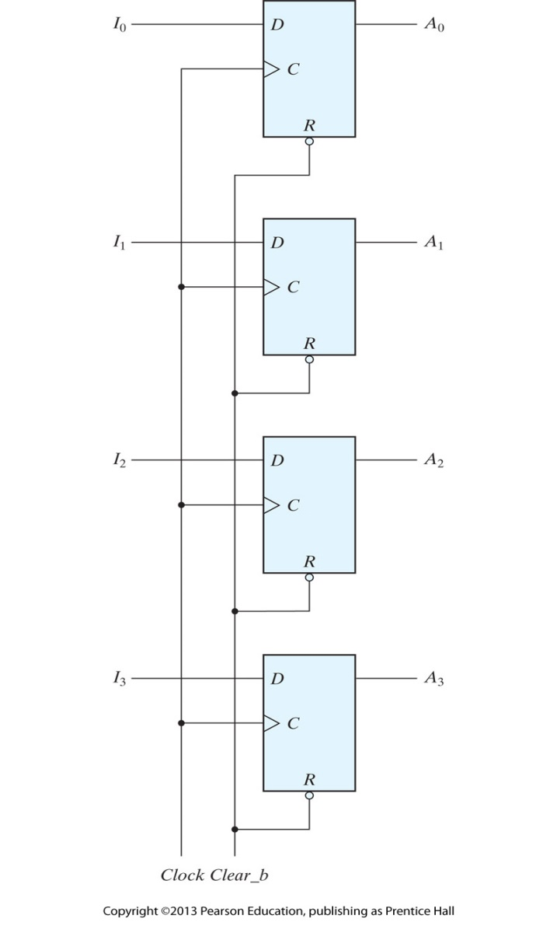
Four‐bit register

Slide 5
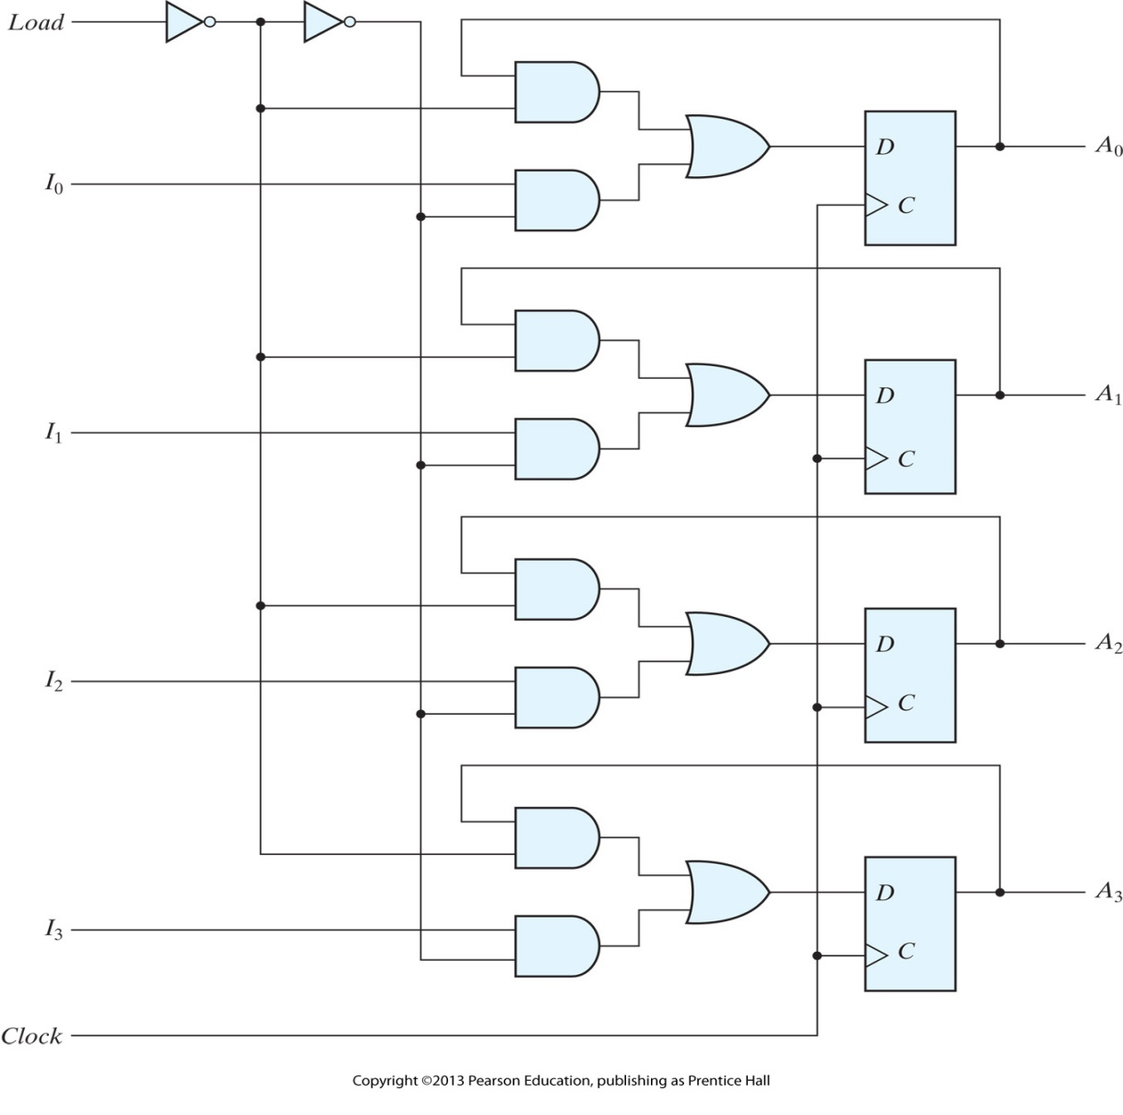
Four‐bit register with parallel load

Slide 6
Shift Registers
A register capable of shifting the binary information held in each cell to its neighboring cell, in a selected direction, is called a shift register.
The logical configuration of a shift register consists of a chain of flip‐flops in cascade, with the output of one flip‐flop connected to the input of the next flip‐flop. All flip‐flops receive common clock pulses, which activate the shift of data from one stage to the next.

Slide 7
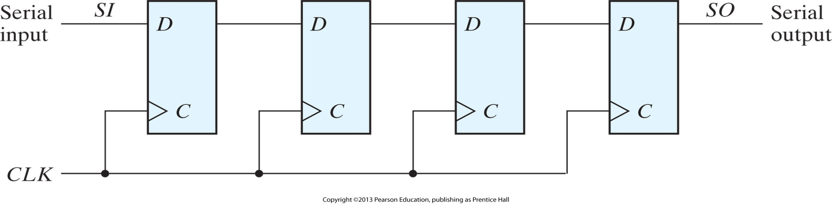
Four‐bit shift register

Slide 8
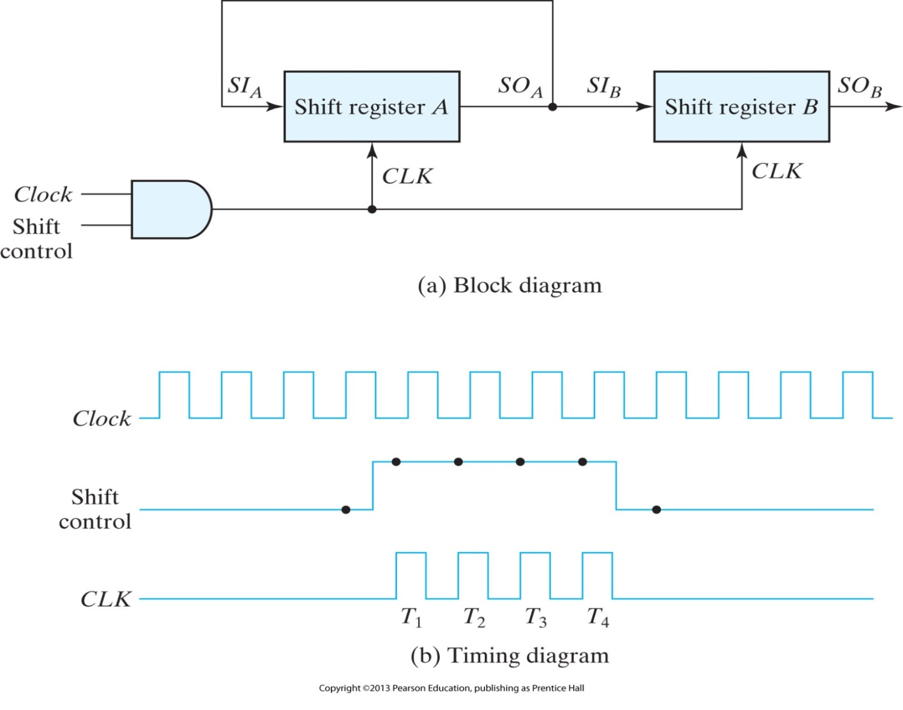
Serial transfer from register A to register B

Slide 9
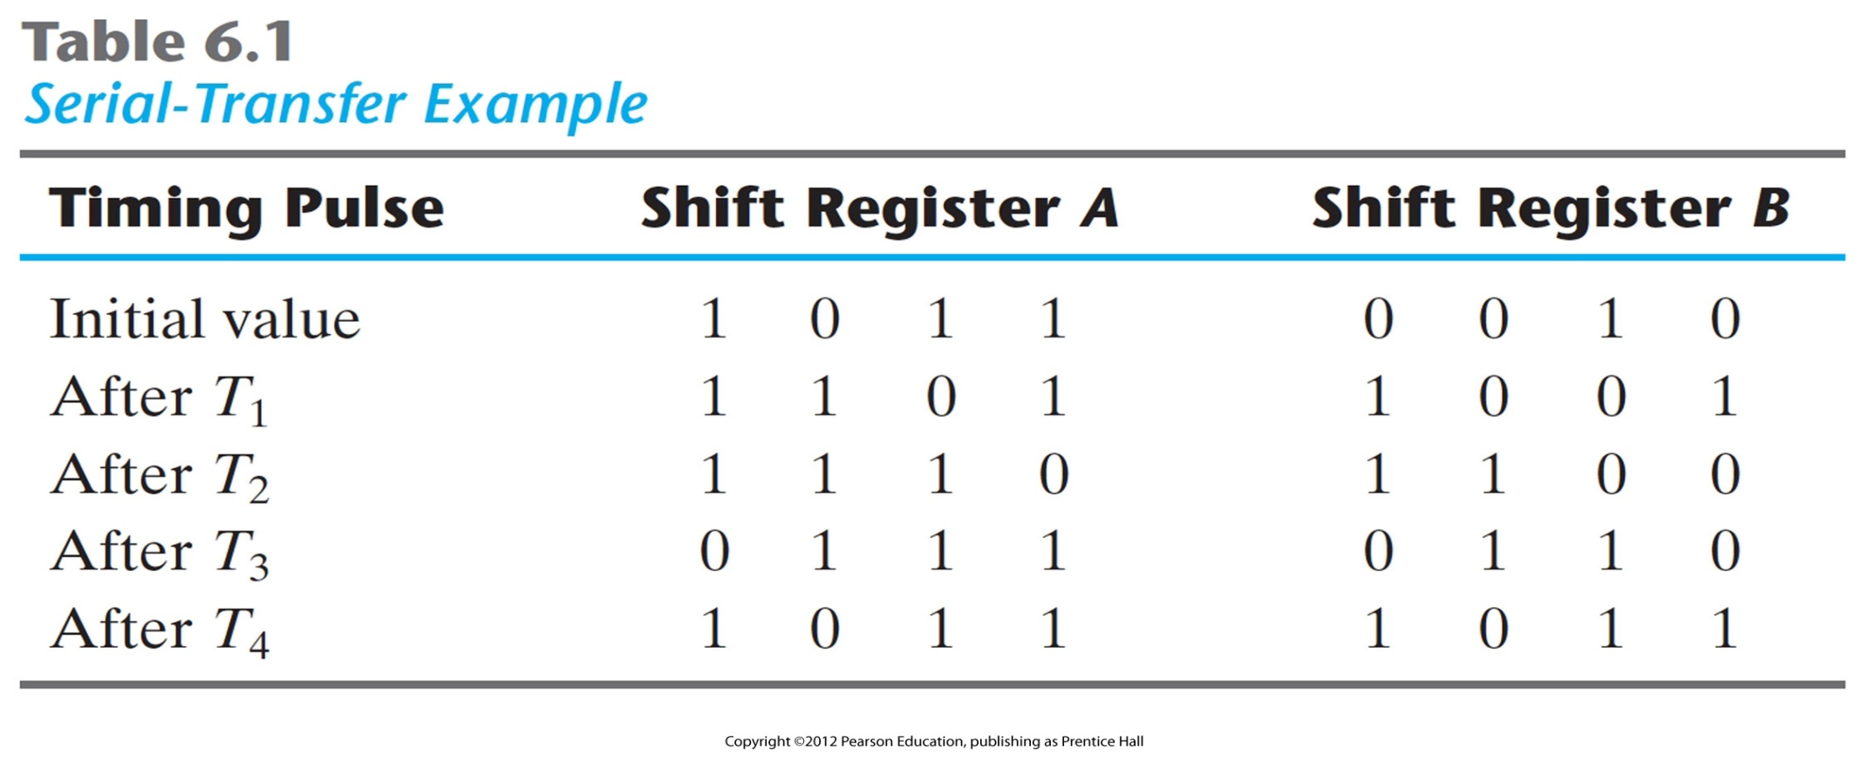
Serial‐Transfer Example

Slide 10
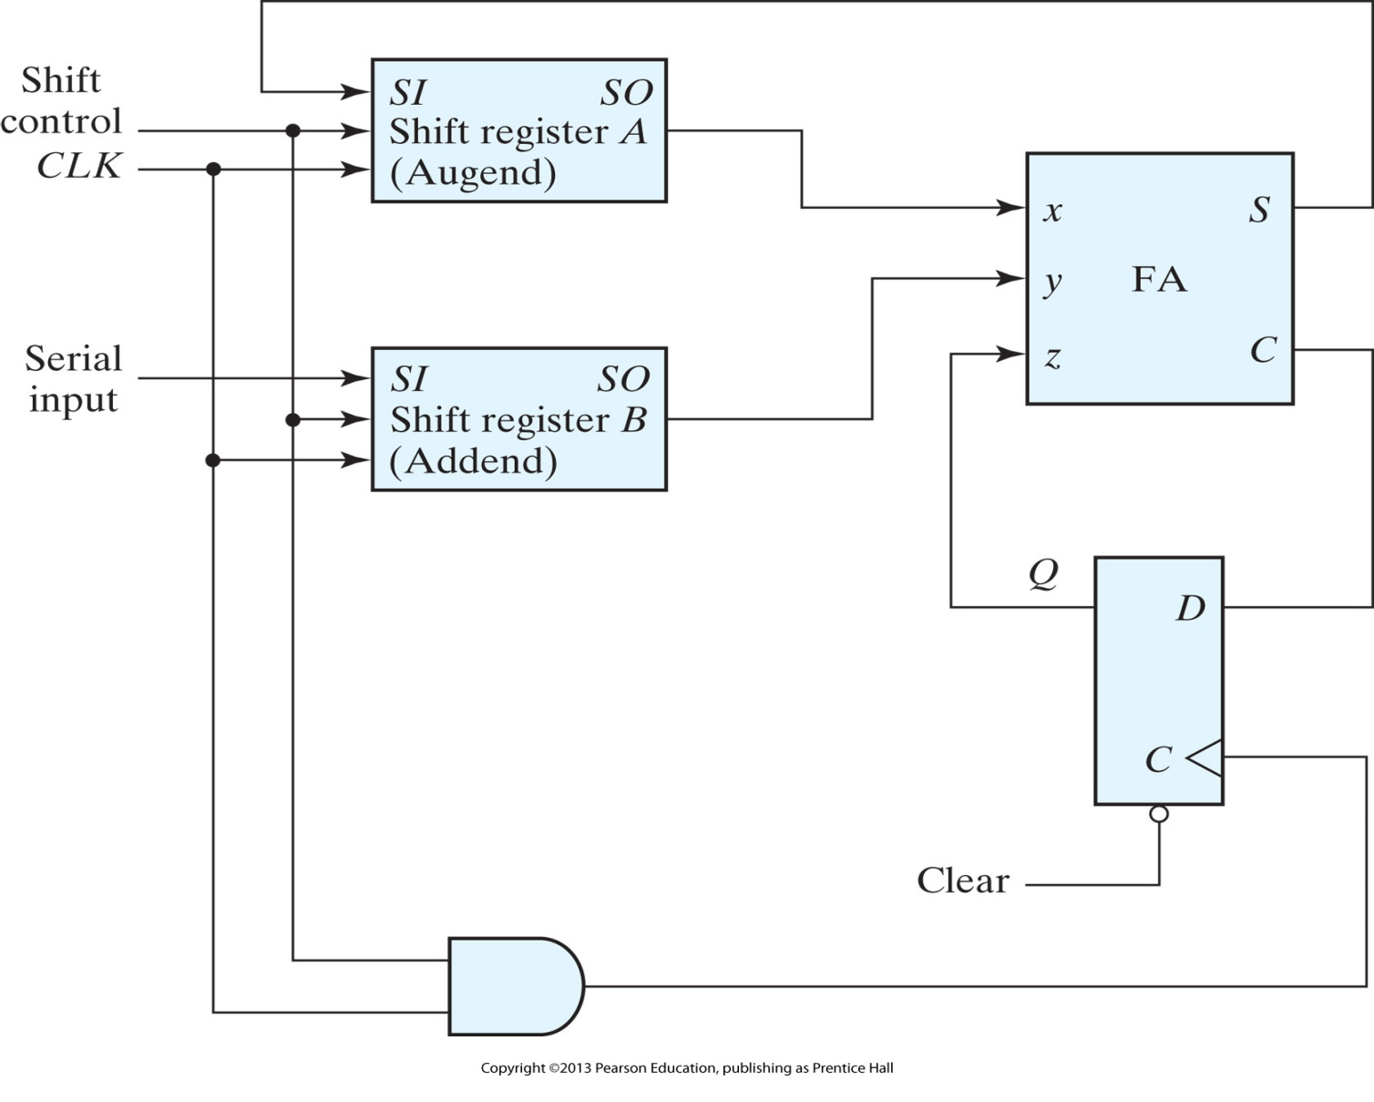
Serial adder

Slide 11
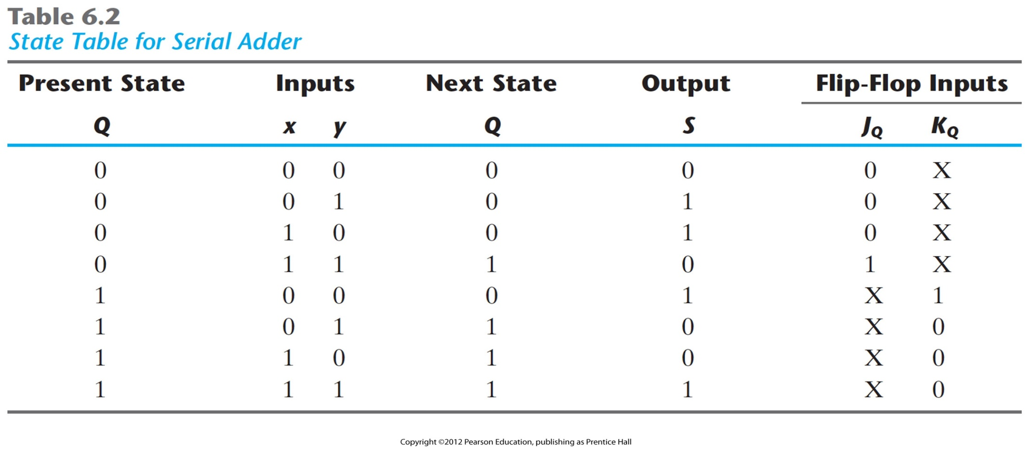
State Table for Serial Adder
Exercise: Derive The two flip‐flop input equations and the output equation!

Slide 12
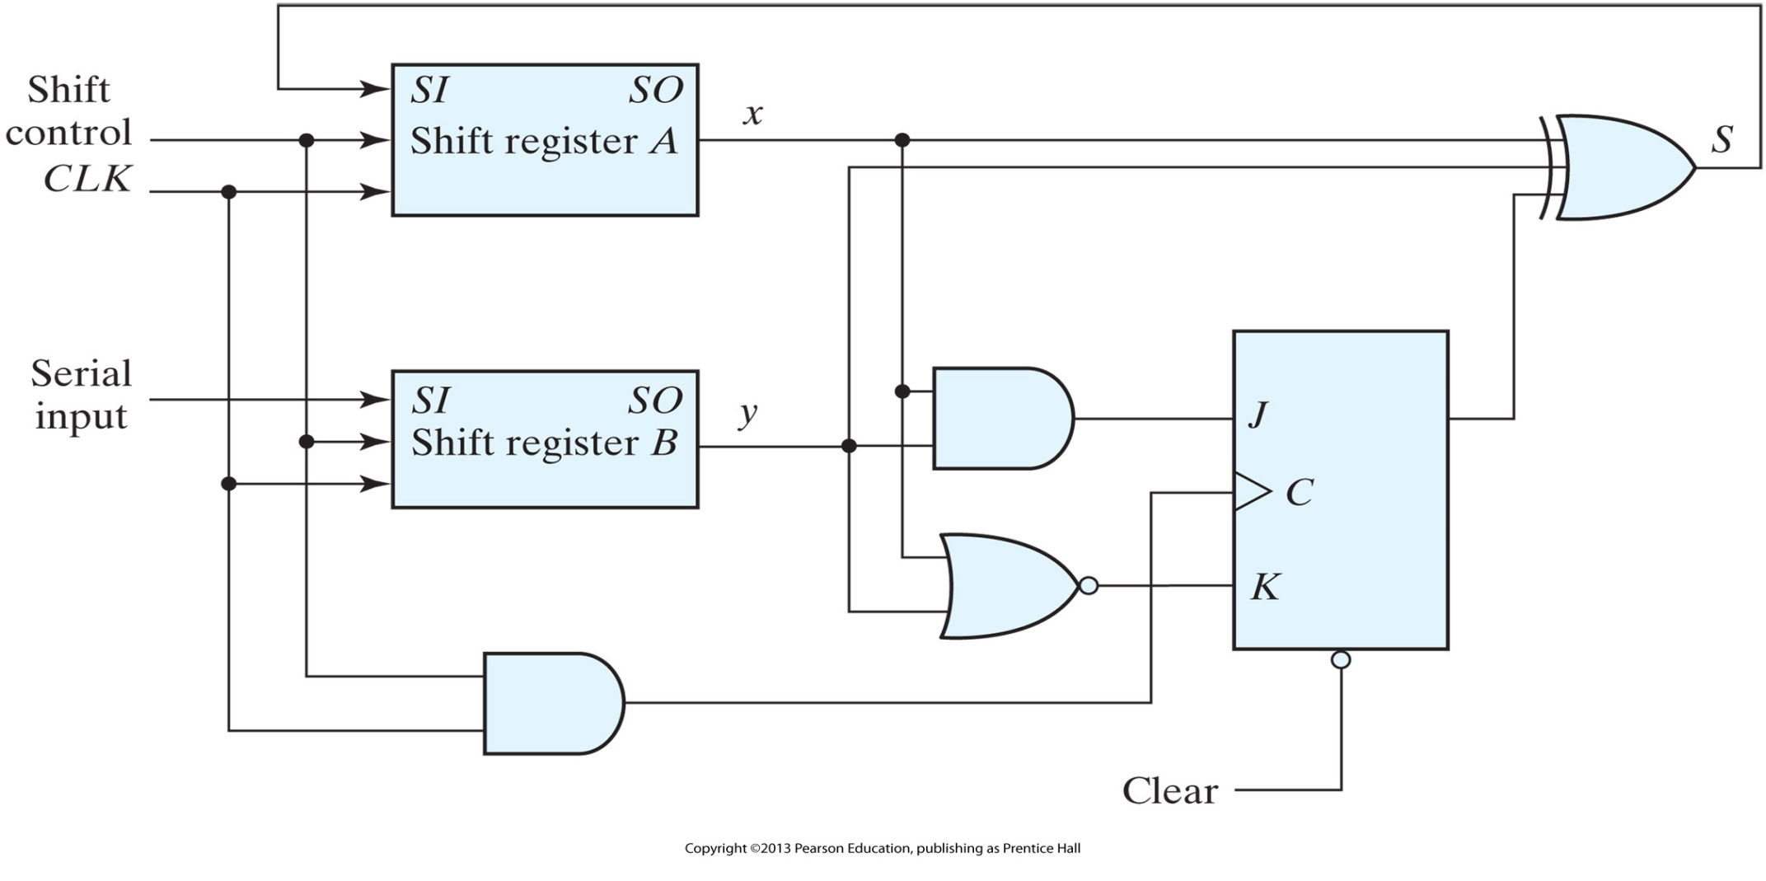
Second form of serial adder

Slide 13
Universal Shift Register
A clear control to clear the register to 0.
A clock input to synchronize the operations.
A shift‐right control to enable the shift‐right operation and the serial input and output lines associated with the shift right.
A shift‐left control to enable the shift‐left operation and the serial input and output lines associated with the shift left.
A parallel‐load control to enable a parallel transfer and the n input lines associated with the parallel transfer.
N parallel output lines.
A control state that leaves the information in the register unchanged in response to the clock. Other shift registers may have only some of the preceding functions, with at least one shift operation.

Slide 14
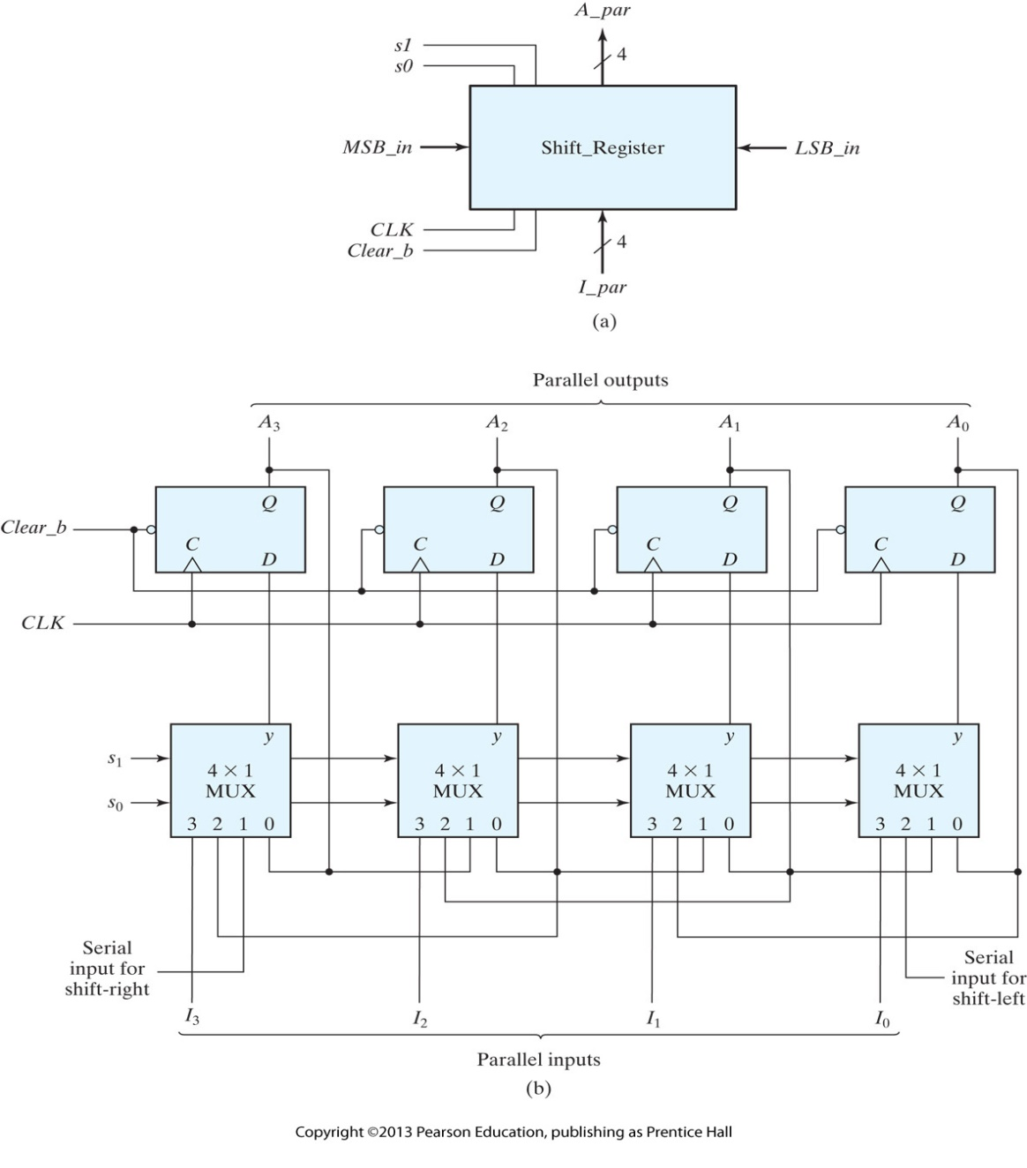
Four‐bit universal shift register

Slide 15
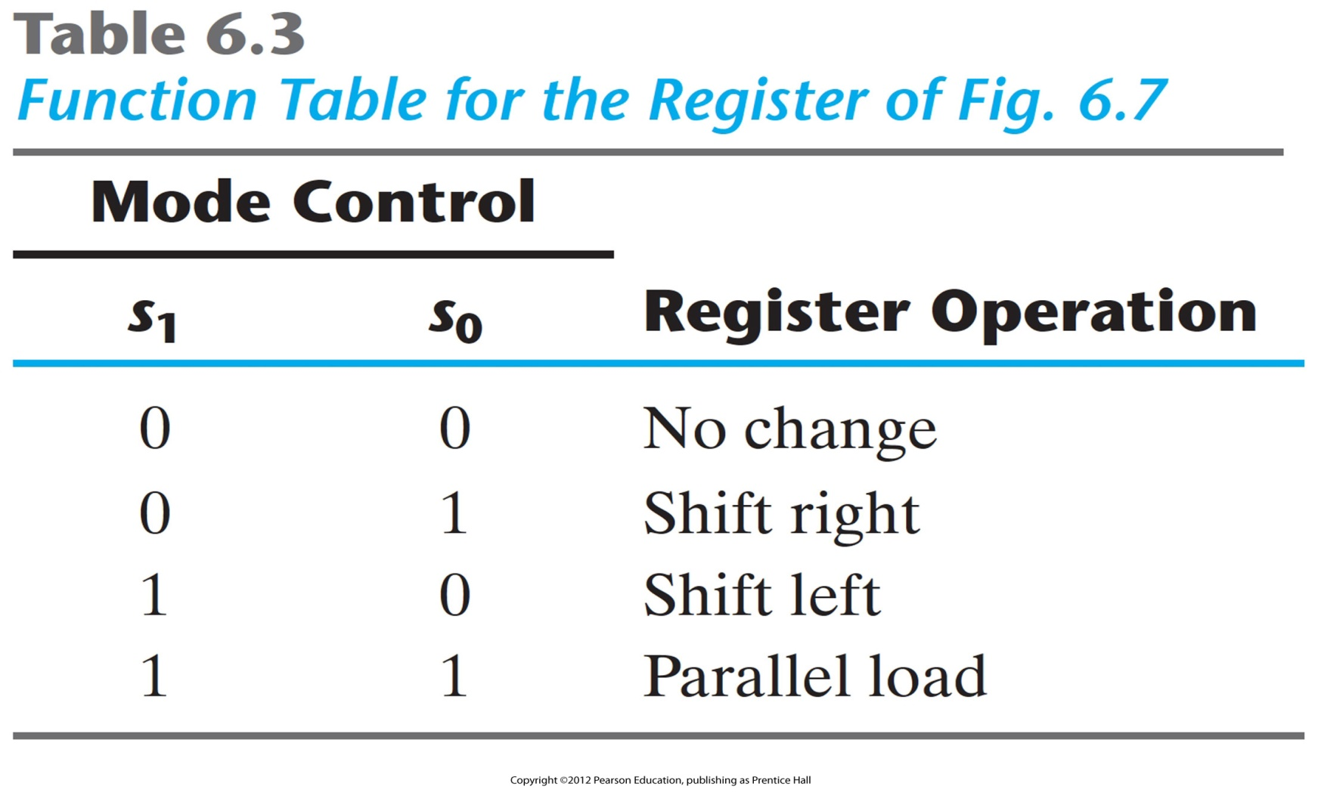
Function Table for the Four‐bit universal shift register

Slide 16
Ripple Counters
A register that goes through a prescribed sequence of states upon the application of input pulses is called a counter. The input pulses may be clock pulses, or they may originate from some external source and may occur at a fixed interval of time or at random.
A counter that follows the binary number sequence is called a binary counter .
An n ‐bit binary counter consists of n flip‐flops and can count in binary from 0 through 2^{n} - 1.
Counters are available in two categories: ripple counters and synchronous counters.

Slide 17
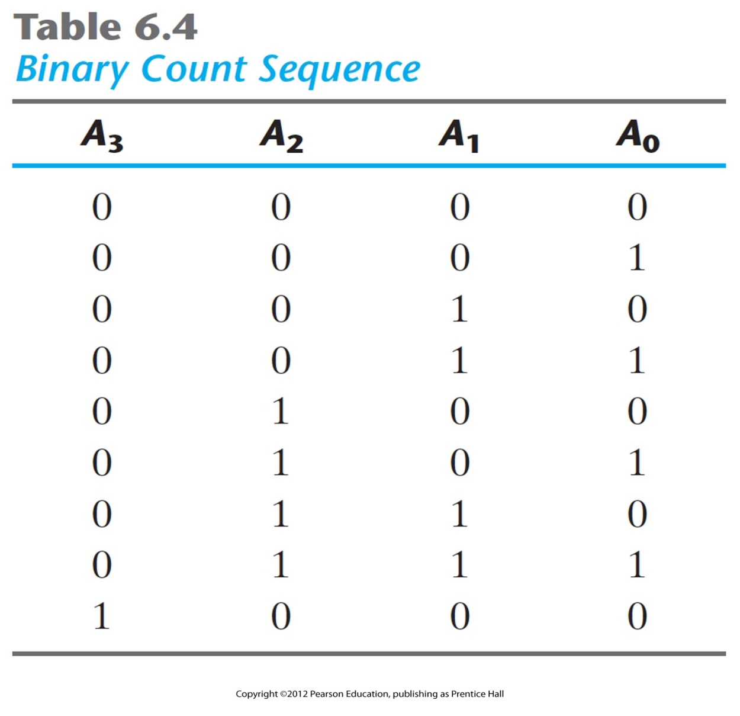
Binary Count Sequence

Slide 18
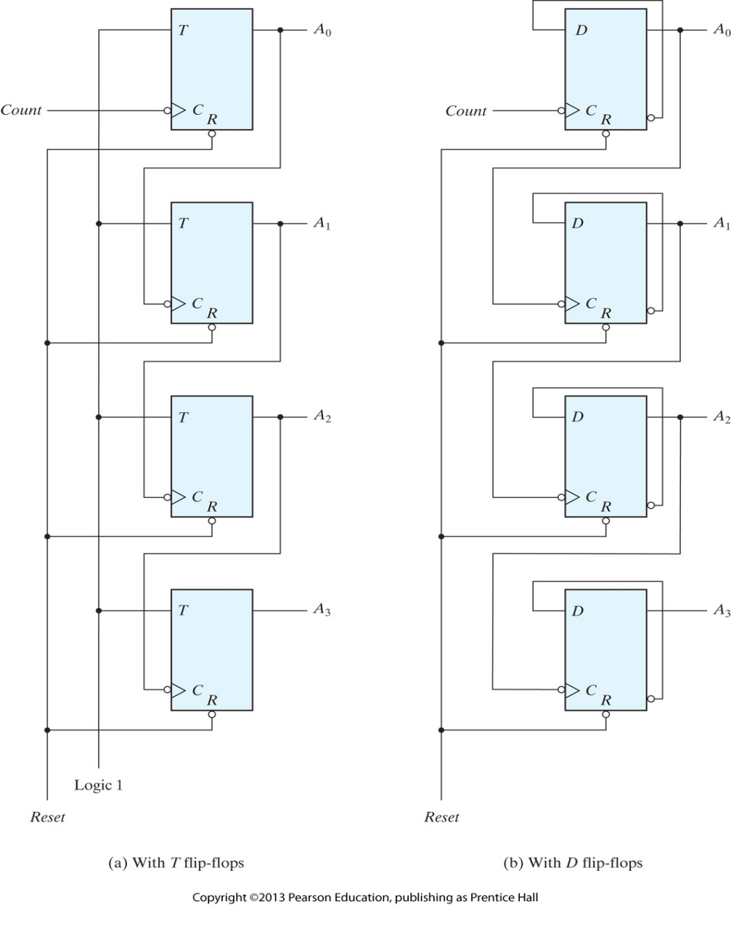
Four‐bit binary ripple counter

Slide 19
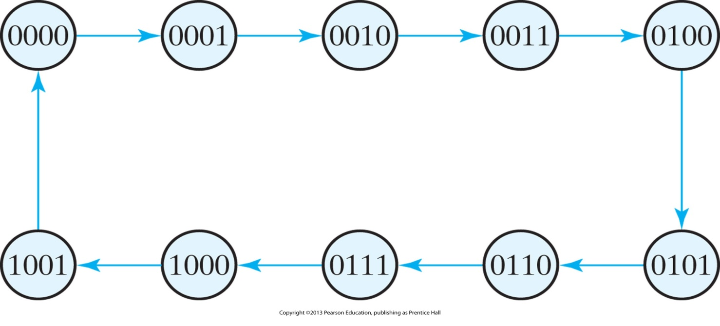
State diagram of a decimal BCD counter
A decimal counter follows a sequence of 10 states and returns to 0 after the count of 9.
At least four flip‐flops to represent each decimal digit, since a decimal digit is represented by a binary code with at least four bits.
The sequence of states in a decimal counter is dictated by the binary code used to represent a decimal digit.

Slide 20
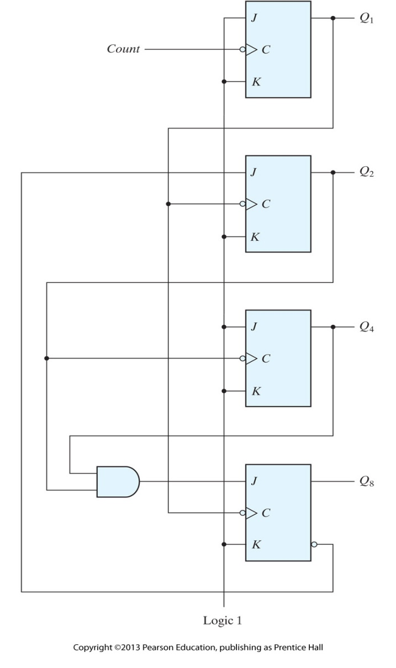
BCD ripple counter
Remember that when the C input goes from 1 to 0, the flip‐flop
  is set if J = 1,
  is cleared if K = 1,
  is complemented if J = K = 1,
  and is left unchanged if J = K = 0.
Q1 changes state after each clock pulse.
Q2 complements every time Q1 goes from 1 to 0, as long as Q8 = 0.
When Q8 becomes 1, Q2 remains at 0.
Q4 complements every time Q2 goes from 1 to 0.
Q8 remains at 0 as long as Q2 or Q4 is 0.
When both Q2 and Q4 become 1, Q8 complements when Q1 goes from 1 to 0.
Q8 is cleared on the next transition of Q1.

Slide 21
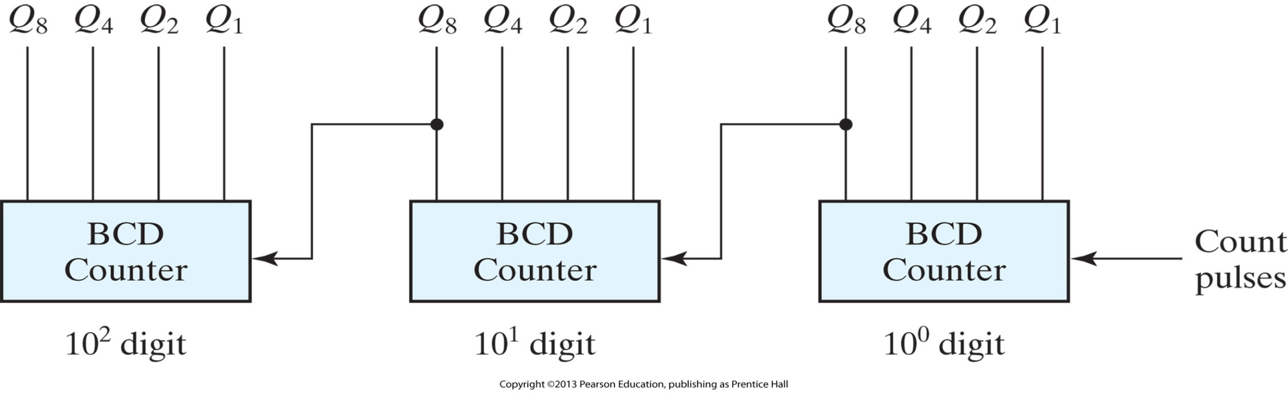
Block diagram of a three‐decade decimal BCD counter

Slide 22
Synchronous Counters
Synchronous counters are different from ripple counters in that clock pulses are applied to the inputs of all flip‐flops.
A common clock triggers all flip‐flops simultaneously, rather than one at a time in succession as in a ripple counter.
The decision whether a flip‐flop is to be complemented is determined from the values of the data inputs, such as T or J and K at the time of the clock edge.
  If T = 0 or J = K = 0, the flip‐flop does not change state.
  If T = 1 or J = K = 1, the flip‐flop complements.

Slide 23
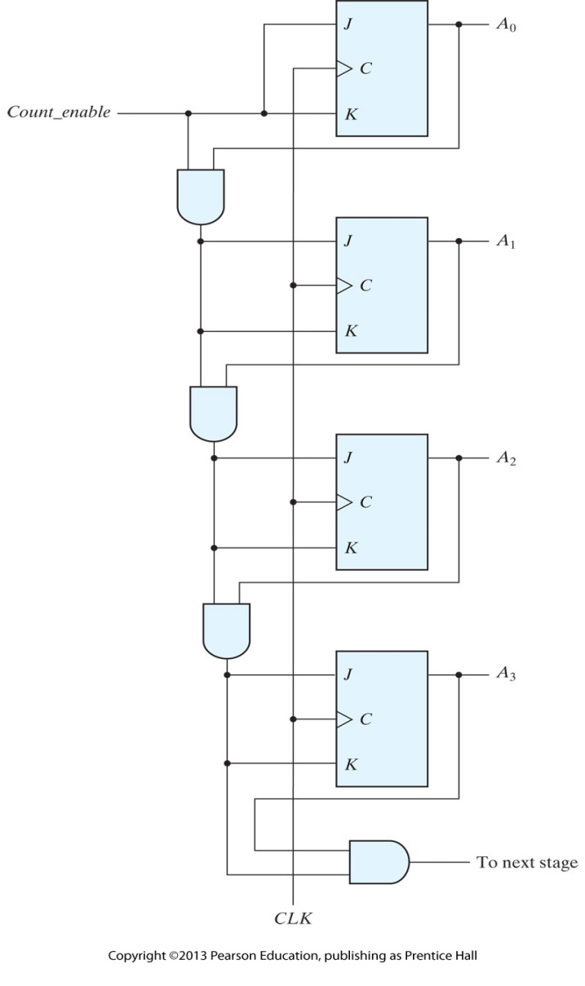
Four‐bit synchronous binary counter

Slide 24
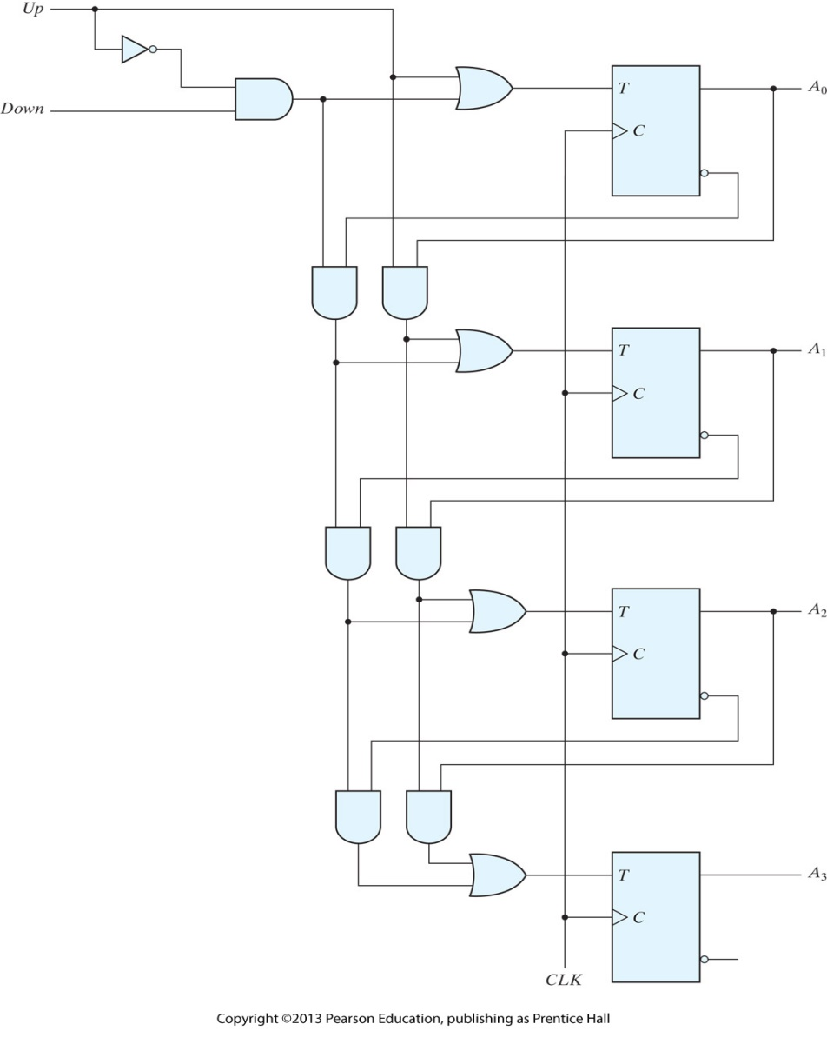
Four‐bit up–down binary counter

Slide 25
BCD Counter
A BCD counter counts in binary‐coded decimal from 0000 to 1001 and back to 0000. Because of the return to 0 after a count of 9, a BCD counter does not have a regular pattern, unlike a straight binary count. To derive the circuit of a BCD synchronous counter, it is necessary to go through a sequential circuit design procedure.

Slide 26
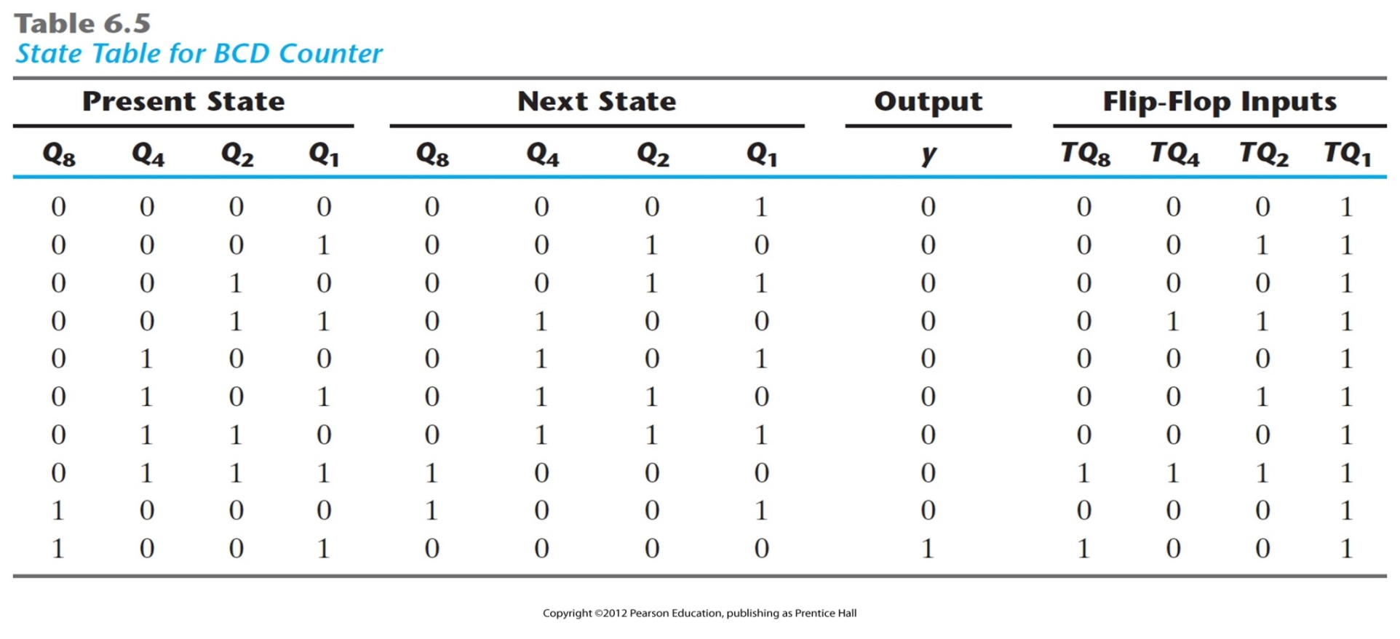
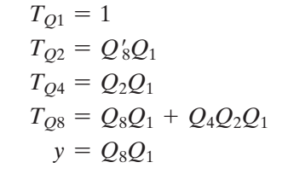

Slide 27
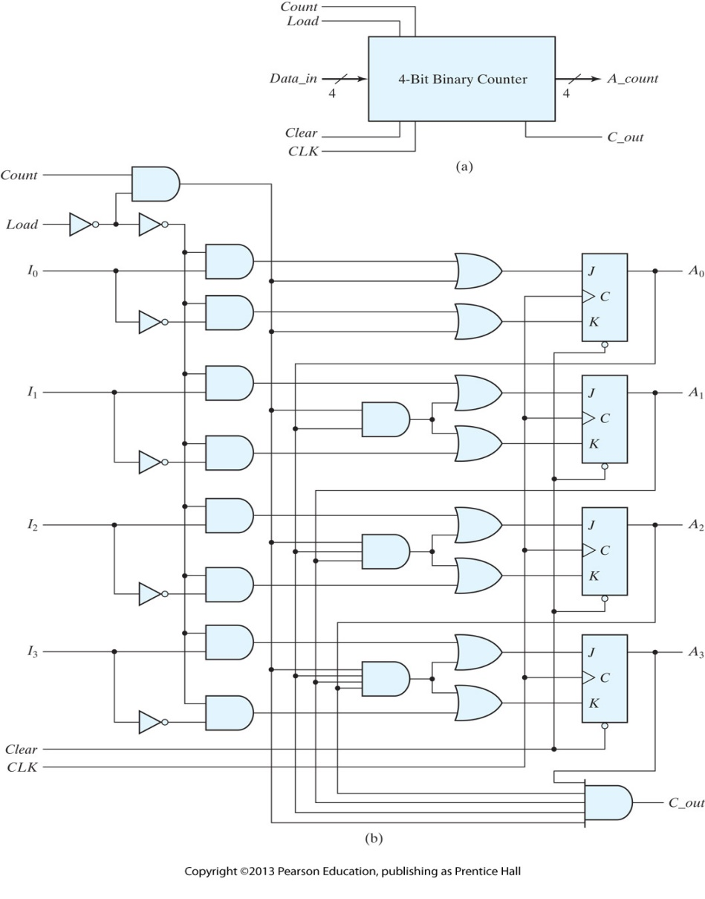
Four‐bit binary counter with parallel load

Slide 28
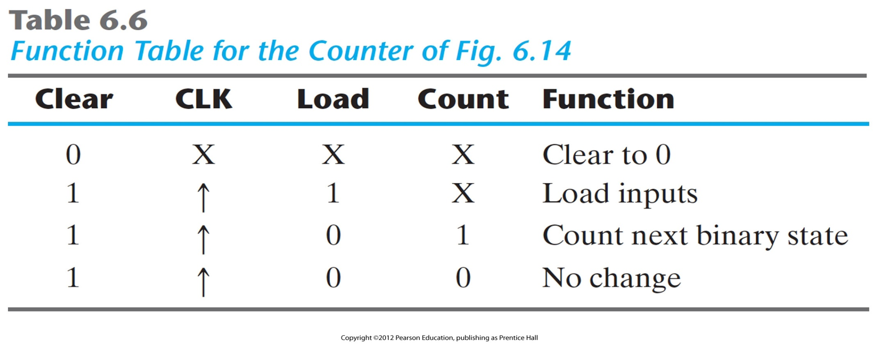
Function Table for the Four‐bit binary counter with parallel load

Slide 29
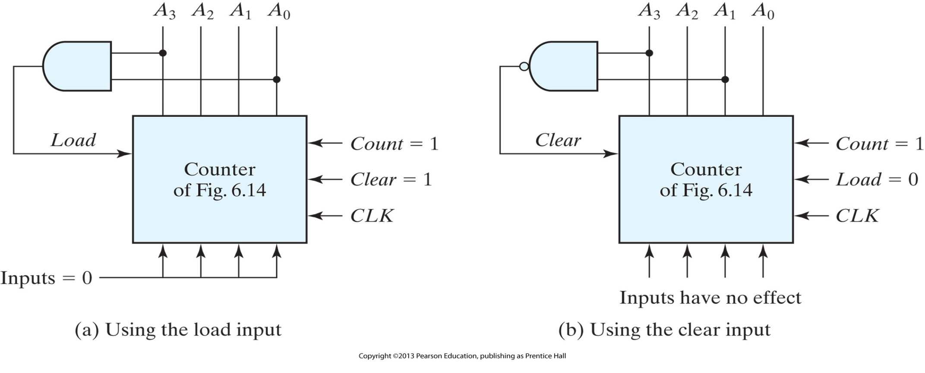
Two ways to achieve a BCD counter using a counter with parallel load

Slide 30
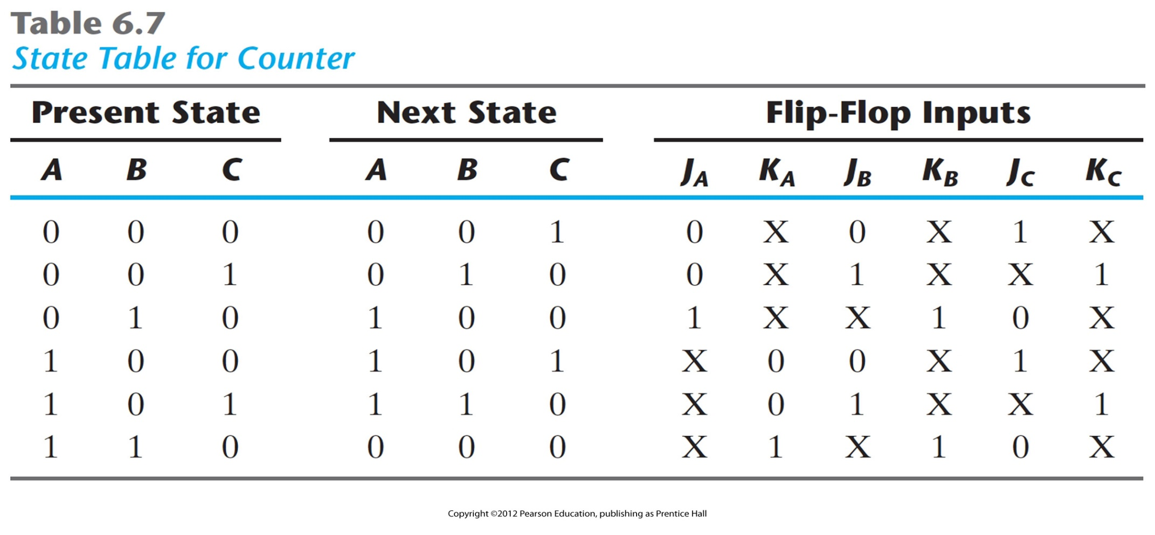
State Table for Counter

Slide 31
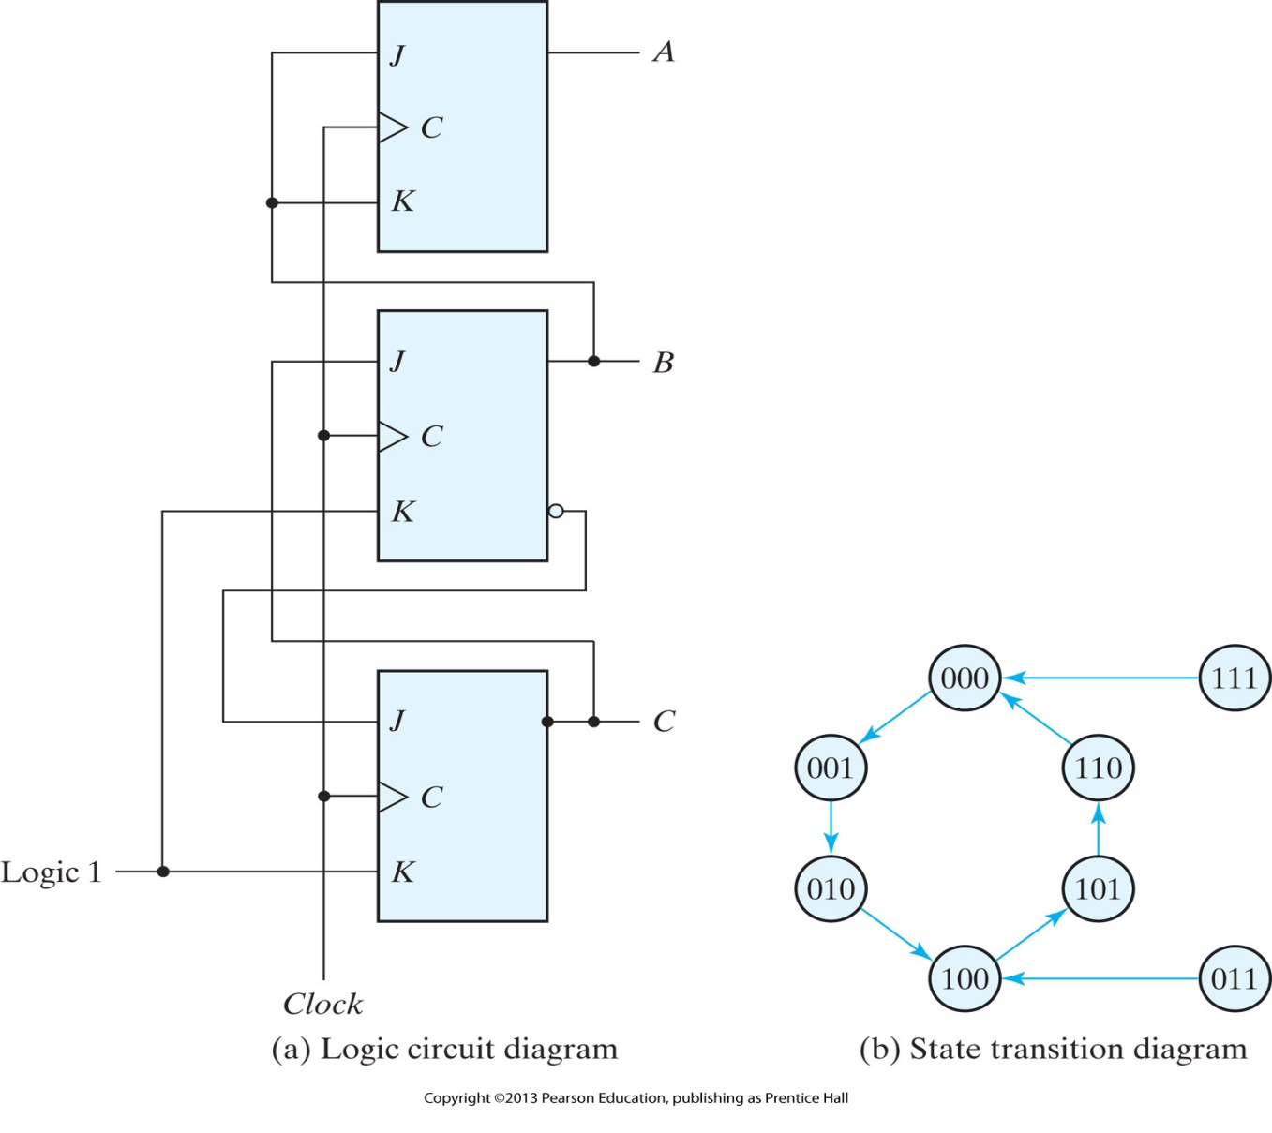
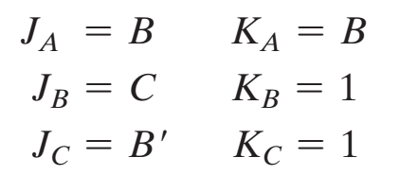
Counter with unused states

Slide 32
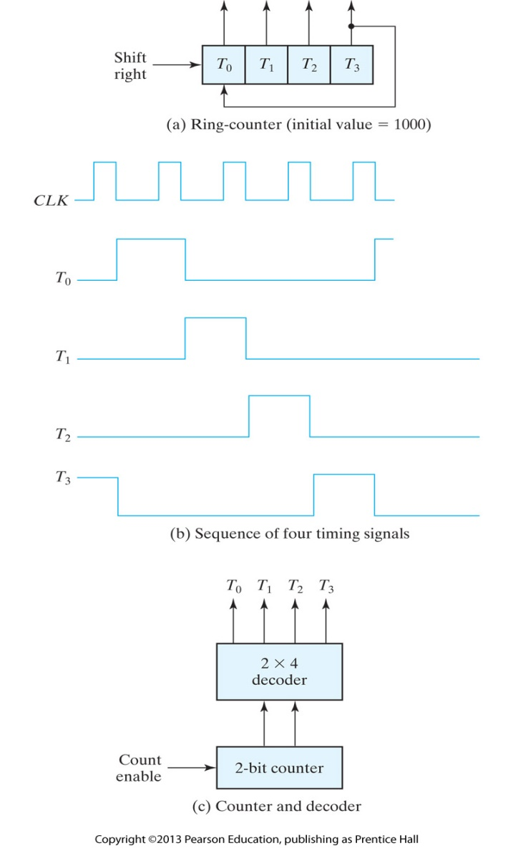
Generation of timing signals

Slide 33
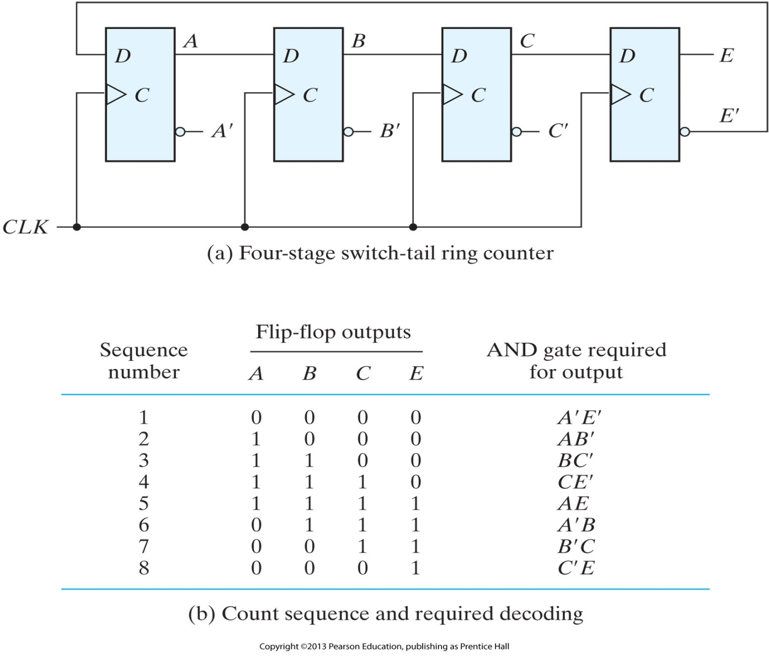
Construction of a Johnson counter
A Johnson counter is a k ‐bit switch‐tail ring counter with 2 k decoding gates to provide outputs for 2 k timing signals.

